Slide 1



2016-17 Mini projects
(SOIS-MU & Philips)
Predictive Analysis on Chronic Kidney Disease
Pretik C P – 161046004
Deepak Nayak – 161046007
Rithin T L - 161046017
Notes:
<number>

Slide 2
Contents
About Chronic Kidney disease
Broad Area & Research challenge
Focus of the project
Proposed Methodology
Software tools Requirements
Timelines

Slide 3
About Chronic kidney disease
Chronic kidney disease (CKD), also known as chronic renal disease, is progressive loss in kidney function over a period of months or years.
How it is identified:
Chronic kidney disease is identified by a blood test for creatinine, which is a breakdown product of muscle metabolism. Higher levels of creatinine indicate a lower glomerular filtration rate and as a result a decreased capability of the kidneys to excrete waste products. Creatinine levels may be normal in the early stages of CKD, and the condition is discovered if urinalysis (testing of a urine sample) shows the kidney is allowing the loss of protein or red blood cells into the urine.
Few Symptoms:
- Blood pressure is increased.
- Urea accumulates.
- Potassium accumulates in the blood.
- Iron deficiency anaemia.

Slide 4
Broad Area and Challenges
Predictive modelling is the process of creating, testing and validating a model to best predict the probability of the outcome
Challenges
The data needs Pre-processing.
Figuring out exactly what we are trying to predict.
Figuring out what assumptions can be safely made about the data and the underlying system.
Which assumptions we can make about the data, we can look at existing algorithms.
When choosing algorithms, we need to verify which algorithm or parameters work best on the data.
Finally, we can use the appropriate algorithm and obtain a model.
Notes:
<number>

Slide 5
Focus of the Project
Build a model to predict the chronic kidney disease
Data sets
- Supervised
ex (Age(numerical) ,Blood Pressure(numerical) ,Specific Gravity(nominal),Albumin(nominal) ,Sugar(nominal) ...etc) like we have total 25 attributes.
Steps
Collecting Data - Be it the raw data from excel, access, text files etc ., (We have excel data sheet)
Preparing Data - Fixing issues of Missing data sets and treatment of outliers ( Outcome – cleaned data)
Training Model - Choosing appropriate algorithm and representation in the form of model.
Splits into two part
Training data - to develop a model
Test data - Used as reference.
Evaluating Model - To test the accuracy , here second part (Test Data) is used.
Improving the Model - Choosing different models altogether or introducing new variables .
ex : Regression , classification

Slide 6
Proposed Approach
Data sets (Pre- Processed)
(Input)
Co-relates data sets (Linear regression)
Machine Learning Algorithms
Classification Rules
Predicted Classification
(Output)
School Of Information Sciences
1

Slide 7
Infrastructure/ Software tools
Operating System | Ubuntu 16.04
Programing Language | R | Gmodels , Caret ,Linear Regression
Data Visualization | Python or R | Matplotlib , Ggplot

Slide 8
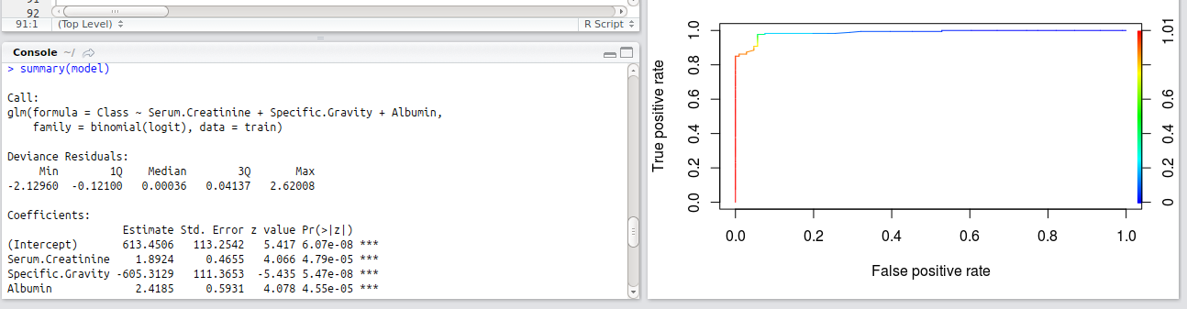
LOGISTIC REGRESSION MODEL:
Logistic regression is the appropriate regression analysis to conduct when the dependent variable is dichotomous (binary). Like all regression analyses, the logistic regression is a predictive analysis. Logistic regression is used to describe data and to explain the relationship between one dependent binary variable and one or more nominal, ordinal, interval or ratio-level independent variables

Slide 9
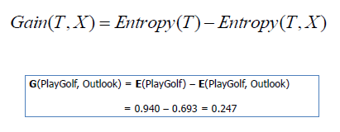
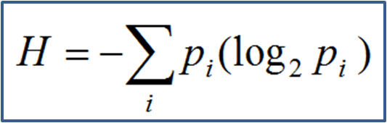
DECISION TREE MODEL:
A decision tree is a machine learning algorithm that partitions the data into subsets.
The partitioning process starts with a binary split and continues until no further splits can be made.
The goal of a decision tree is to encapsulate the training data in the smallest possible tree.

Slide 10
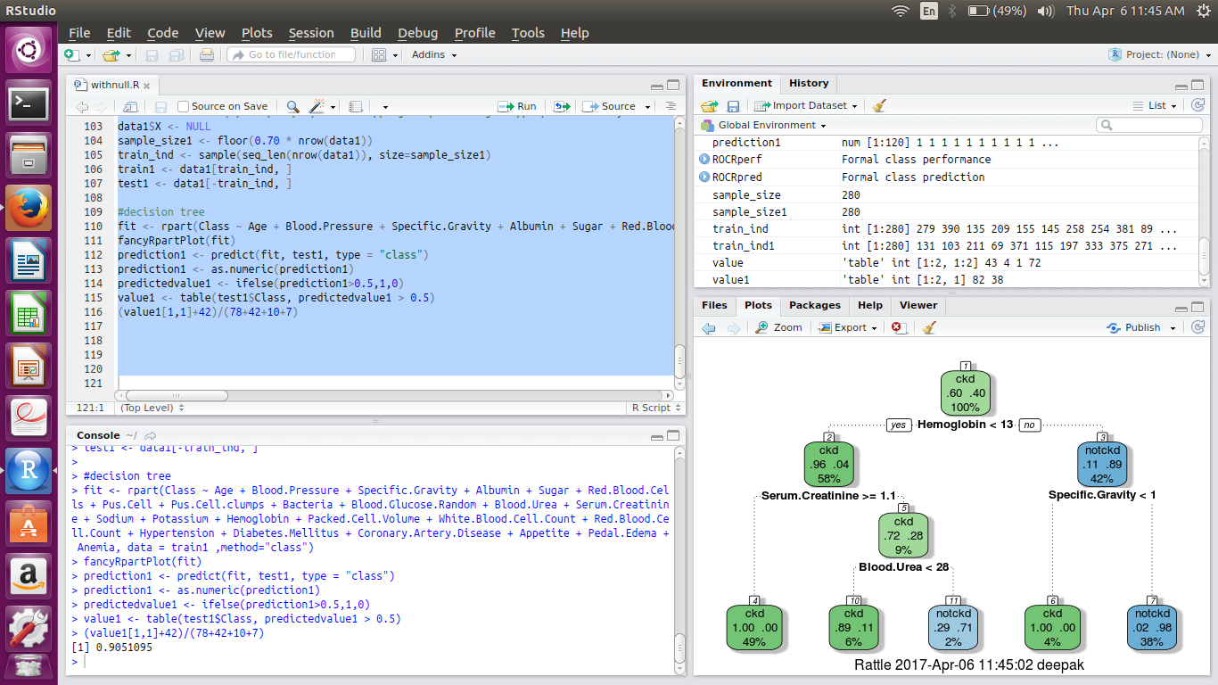

Slide 11
Time line
Tentative Date | Description
Week 1 & Week 2 | Literature survey and Data Pre-processing choosing co-relation between variables
Week 3 | Finding co-relation between variables with Target Variable (linear Regression)
Week 4 & Week 5 | Training Model sets
Week 6 & Week 7 | Evaluating Model

Slide 12
Thank You
School Of Information Sciences
<number>

